Slide 1

APEX INSTITUTE OF TECHNOLOGY
DEPARTMENT OF COMPUTER SCIENCE & ENGINEERING
Machine Learning (21CSH-286)
Faculty: Prof. (Dr.) Madan Lal Saini(E13485)
Lecture – 19
Performance Metrix for Regression
DISCOVER . LEARN . EMPOWER

Slide 2
COURSE OBJECTIVES
The Course aims to:
Understand and apply various data handling and visualization techniques.
Understand about some basic learning algorithms and techniques and their applications, as well as general questions related to analysing and handling large data sets.
To develop skills of supervised and unsupervised learning techniques and implementation of these to solve real life problems.
To develop basic knowledge on the machine techniques to build an intellectual machine for making decisions behalf of humans.
To develop skills for selecting suitable model parameters and apply them for designing optimized machine learning applications.

Slide 3
COURSE OUTCOMES
On completion of this course, the students shall be able to:-
CO1 | Understand machine learning techniques and computing environment that are suitable for the applications under consideration.
CO2 | Understand data pre-processing techniques and apply these for data cleaning.
CO3 | Identify and implement simple learning strategies using data science and statistics principles.
CO4 | Evaluate machine learning model’s performance and apply learning strategy to improve the performance of supervised and unsupervised learning model.
CO5 | Develop a suitable model for supervised and unsupervised learning algorithm and optimize the model on the expected accuracy.

Slide 4
Unit-2 Syllabus
Unit-2 | Supervised Learning | Contact Hours: 10 Hours
Regression | Linear regression, Ridge Regression, Lasso Regression, and Bayesian Linear Regression.
Classification | Types of Classification Algorithm: Binary Classification and Multi-Class Classification, Logistic Regression, K-Nearest Neighbours, Decision Trees, Random Forest, Support Vector Machine.
Performance Metrics | Performance metrics for Regression: Mean Absolute Error, Mean Squared Error, Root Mean Squared Error, R-Squared; Performance metrics for classification: Confusion Matrix, Accuracy, Precision, Recall, F1 score.

Slide 5
SUGGESTIVE READINGS
TEXT BOOKS:
T1: Tom.M.Mitchell, “Machine Learning, McGraw Hill International Edition”.
T2: Ethern Alpaydin,” Introduction to Machine Learning. Eastern Economy Edition, Prentice Hall of India, 2005”.
T3: Andreas C. Miller, Sarah Guido, Introduction to Machine Learning with Python, O’REILLY (2001).
REFERENCE BOOKS:
R1 Sebastian Raschka, Vahid Mirjalili, Python Machine Learning, (2014)
R2 Richard O. Duda, Peter E. Hart, David G. Stork, “Pattern Classification, Wiley, 2nd Edition”.
R3 Christopher Bishop, “Pattern Recognition and Machine Learning, illustrated Edition, Springer, 2006”.

Slide 6


Contents to be Covered
Performance metrics for Regression
Mean Absolute Error
Mean Squared Error
Root Mean Squared Error
R-Squared;

Slide 7
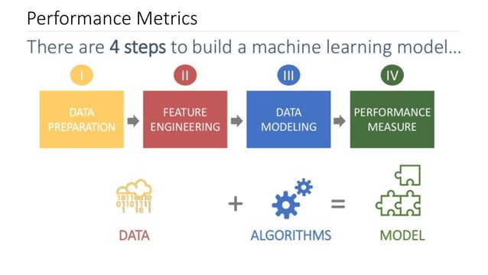

Slide 8
Why We require Evaluation Metrics?
Most beginners and practitioners most of the time do not bother about the model performance. The talk is about building a well-generalized model, Machine learning model cannot have 100 per cent efficiency otherwise the model is known as a biased model, which further includes the concept of overfitting and underfitting.
It is necessary to obtain the accuracy on training data, But it is also important to get a genuine and approximate result on unseen data otherwise Model is of no use.
So to build and deploy a generalized model we require to Evaluate the model on different metrics which helps us to better optimize the performance, fine-tune it, and obtain a better result.

Slide 9

Regression Evaluation Metrics
Mean Absolute Error (MAE)
Mean Squared Error (MSE)
Root Mean Square Error( RMSE)

Slide 10
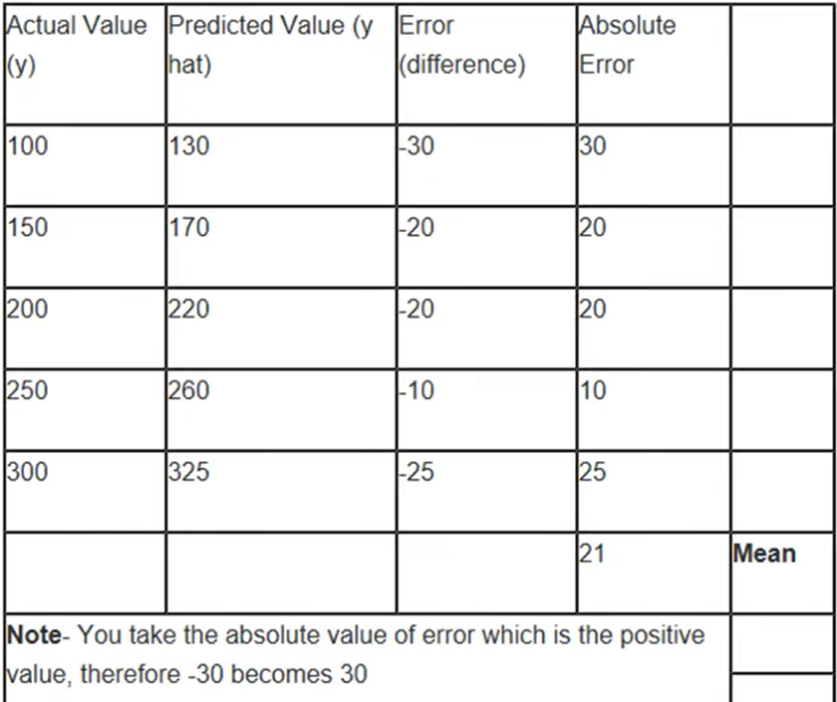
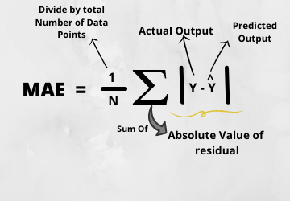
Mean Absolute Error(MAE)
In simple terms, mean absolute error is the sum of absolute/positive error of all values

Slide 11
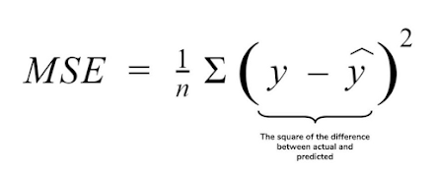
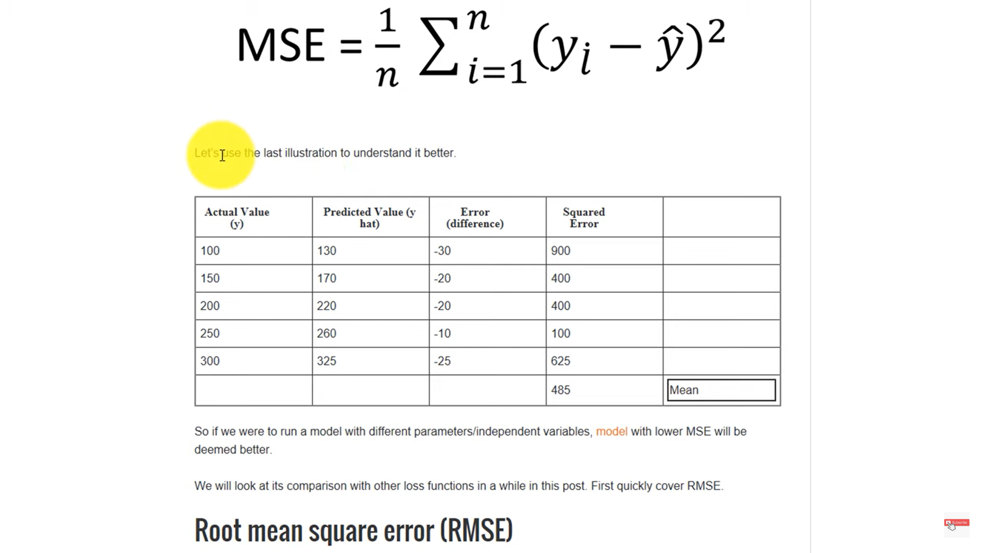
Mean Squared Error(MSE)
MSE is a most used and very simple metric with a little bit of change in mean absolute error. Mean squared error states that finding the squared difference between actual and predicted value.
It is always positive and value closer to 0 or a lower value is better

Slide 12
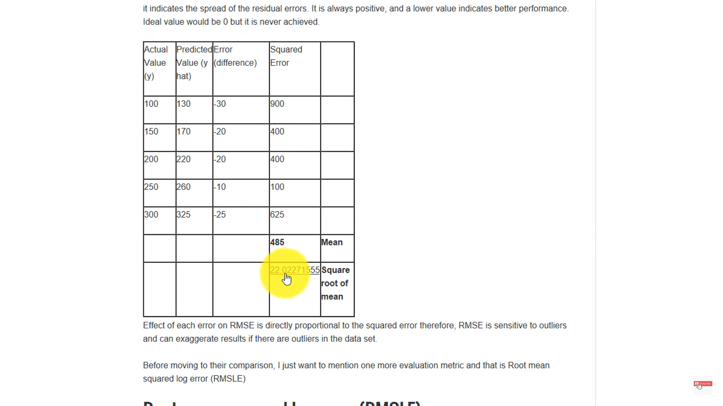
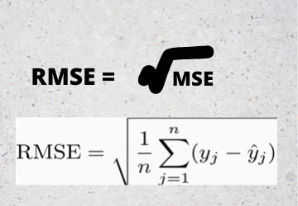
Root Mean Squared Error(RMSE)
As RMSE is clear by the name itself, that it is a simple square root of mean squared error.

Slide 13
R Squared
It is also known as the coefficient of determination. This metric gives an indication of how good a model fits a given dataset. It indicates how close the regression line (i.e the predicted values plotted) is to the actual data values. The R squared value lies between 0 and 1 where 0 indicates that this model doesn't fit the given data and 1 indicates that the model fits perfectly to the dataset provided.

Slide 14
Evaluation Metrics Pros and Cons
MAE: it doesn’t account for the direction of the value. Even if the value is negative, positive value is used for calculation.
It is less biased for higher value.it may not adequately reflect the performance when dealing with large error values.
MSE: it does account for positive and negative value and it is highly biased for higher value
RMSE: it also does account for positive and negative value. It is better in terms of reflecting performance when dealing with large error value. RMSE penalize large error

